Slide 1
CSS Complete Training
Cascading Style Sheets — From Basics to Responsive Design
CSS Basics
Box Model
Flexbox
CSS Grid
Responsive Design
Animations
MERN Stack Training • HTML → CSS → JavaScript → React

Slide 2
Today's Session Roadmap
What We'll Cover Today
🎨 CSS Basics
📦 Flexbox
🗂️ CSS Grid
Selectors, Properties, Box Model
1D layout, alignment, spacing
2D layout, rows & columns
🔄 Transitions & Animations
📱 Responsive Design
💡 Problem Statements
Hover effects, keyframes
Media queries, mobile-first
Hands-on coding exercises

Slide 3
SECTION 1: CSS Basics
Selectors • Properties • Box Model • Colors

Slide 4
What is CSS?
Cascading Style Sheets — adds style and design to your HTML
🏗️ HTML
🎨 CSS
⚡ JS
Defines WHAT is on the page. The structure/skeleton.
Defines HOW things LOOK. Colors, fonts, layout, spacing.
Defines what things DO. Interactions, animations.
3 Ways to Add CSS
<!-- 1. Inline CSS -->
<p style="color: red;
font-size: 20px;">
Hello World!
</p>
/* 2. Internal CSS */
<style>
p {
color: blue;
font-size: 18px;
}
</style>
/* 3. External CSS */
<link rel="stylesheet"
href="style.css">
/* style.css */
p { color: green; }
Best Practice: Always use External CSS — it keeps HTML clean and CSS reusable across multiple pages.

Slide 5
CSS Selectors
They tell CSS which HTML element to style
Element
ID #main
p { }
Selects all <p> tags on the page
#main { }
Selects ONE unique element with id='main'
Use hash (#) before id name
Class .highlight
Universal *
.highlight { }
Selects elements with class='highlight'
Use dot (.) before class name
* { margin: 0; }
Selects ALL elements on the page
Used to reset default browser styles

Slide 6
CSS Typography Properties
Controlling text appearance — size, color, font, alignment
font-size
color
p { font-size: 24px; }
Controls text size. Bigger number = bigger text. Units: px, em, rem
p { color: #FF5733; }
Text color. Use names, hex (#FF5733), or RGB (rgb(255,87,51))
font-family
text-align
p { font-family: Arial, sans-serif; }
Browser tries first font (Arial), falls back to sans-serif if unavailable
p { text-align: center; }
Horizontal alignment: left | right | center | justify
line-height
font-weight
p { line-height: 1.5; }
Space between lines. 1.5 = 1.5× the font-size. Makes text readable
p { font-weight: bold; }
Text thickness: normal | bold | 100–900 (lighter → bolder)

Slide 7
CSS Background Properties
Control element backgrounds with color or images
.box {
background-color: yellow;
}
.hero {
background-image: url('image.jpg');
background-size: cover; /* fill the box */
background-repeat: no-repeat;
background-position: center;
}
background-color
yellow / #fff / rgb()
background-image
url('image.jpg')
background-size
cover | contain | 100px
background-repeat
no-repeat | repeat
background-position
center | top left
💡 background-size: cover → makes image always fill the container (may crop slightly). Best for hero sections!
background-size: cover → makes image always fill the container (may crop slightly). Best for hero sections!
Common Background Shorthand:
.box { background: url('bg.jpg') center/cover no-repeat; }

Slide 8
The CSS Box Model
Every HTML element is a box — understanding this is KEY to layout!
margin
Margin
border
Space OUTSIDE the border. Pushes element away from others. Transparent.
padding
Border
The LINE around the element. Has color, thickness and style.
content
Padding
Space INSIDE the border. Between content and border.
Content
The actual text, image, or child elements inside the box.
.box {
width: 200px; padding: 10px;
border: 5px solid black;
margin: 20px;
}

Slide 9
CSS Combinators
Select elements based on their relationship to other elements
Descendant (A B)
Child (A > B)
div p { color: blue; }
Selects ALL <p> inside <div>, no matter how deep they are.
div > p { color: red; }
Selects only DIRECT children of <div>. Nested <p> inside <span> is NOT selected.
Adjacent Sibling (A + B)
General Sibling (A ~ B)
h1 + p { color: green; }
Selects the FIRST <p> that comes immediately AFTER <h1>. Only the very next sibling.
h2 ~ p { color: purple; }
Selects ALL <p> elements that come AFTER <h2> with the same parent.

Slide 10
CSS Pseudo-Classes
Style elements based on their STATE — :hover, :focus, :active, :nth-child...
:hover
:active
button:hover { background: blue; }
Triggered when mouse moves OVER the element
button:active { background: red; }
Triggered while element is being CLICKED
:focus
:visited
input:focus { border: 2px solid green; }
Triggered when input/form element is SELECTED
a:visited { color: purple; }
Styles links that have already been VISITED
:first-child
:last-child
li:first-child { color: red; }
Selects the FIRST child of its parent element
li:last-child { color: red; }
Selects the LAST child of its parent element

Slide 11
SECTION 2: CSS Flexbox 📦
One-dimensional layout system for rows & columns

Slide 12
What is Flexbox?
A 1D layout system — arranges items in a row OR column
Flex Container (Parent → display: flex)
Flex Item 1
Flex Item 2
Flex Item 3
display: flex
align-items
Activates Flexbox on the parent container
Aligns items along CROSS axis (vertical in row)
flex-direction
gap
row (default, left→right) | column (top→bottom)
Space between flex items (cleaner than margin)
justify-content
flex-wrap
Aligns items along MAIN axis (horizontal in row)
wrap = items move to next line when no space

Slide 13
Flexbox Properties
justify-content, align-items, flex-direction, gap
justify-content (Main Axis)
flex-start
center
flex-end
space-between
space-around
align-items (Cross Axis)
flex-start
center
flex-end
stretch
baseline
.container {
display: flex;
flex-direction: row; /* row | column */
justify-content: space-between; /* main axis */
align-items: center; /* cross axis */
gap: 20px; /* spacing */
flex-wrap: wrap; /* wrapping */
}
Common Patterns
• Center everything: justify-content: center + align-items: center
• Equal spacing: justify-content: space-between
• Vertical stack: flex-direction: column
• Responsive wrap: flex-wrap: wrap + width on items

Slide 14
SECTION 3: CSS Grid 🗂️
Two-dimensional layout — rows AND columns together

Slide 15
CSS Grid
2D layout system — control both rows AND columns
Grid Container (display: grid)
.container {
display: grid;
grid-template-columns: 1fr 1fr 1fr; /* 3 equal cols */
grid-template-rows: 200px 200px;
gap: 20px;
}
/* or shorthand */
.container {
grid-template-columns: repeat(3, 1fr);
grid-auto-rows: minmax(100px, auto);
}
Item 1
Item 2
Item 3
Item 4
Item 5
Item 6
Flexbox vs Grid
📦 Flexbox → 1D (row OR column). Great for navbars, card rows, centering single items.
🗂️ Grid → 2D (rows AND columns). Great for full page layouts, dashboards, image galleries.

Slide 16
Grid Properties
grid-template-columns, rows, gap, span, and placement
grid-template-columns
grid-template-rows
repeat(3, 1fr)
3 equal-width columns. 1fr = 1 fraction of available space
200px auto 100px
Define each row's height. auto = size to content
gap / column-gap / row-gap
grid-column
gap: 20px
Spacing between grid cells. Replaces grid-gap (old)
grid-column: 1 / 3;
Item spans from column line 1 to 3 (spans 2 cols)
grid-row
grid-template-areas
grid-row: span 2;
Item spans across 2 rows. Great for feature cards
"header header"
"sidebar main"
Named layout zones — very readable and visual

Slide 17
SECTION 4: Transitions & Animations 🔄
Make your website feel alive with smooth effects

Slide 18
CSS Transitions
Smooth animated change between two states
transition: property duration timing-function delay;
button {
background-color: blue;
transition: background-color 0.3s ease;
}
button:hover {
background-color: darkblue;
}
/* Transition multiple properties */
.box {
width: 100px;
opacity: 1;
transition: width 0.5s ease,
opacity 0.3s ease-in;
}
.box:hover {
width: 200px;
opacity: 0.5;
}
Timing Functions
Common Transition Use Cases
ease
Slow → Fast → Slow (default)
✓ Button hover color change
linear
Constant speed throughout
✓ Card lift with box-shadow
ease-in
Starts slow, ends fast
✓ Menu slide-in (height/max-height)
ease-out
Starts fast, ends slow
✓ Image zoom on hover (transform: scale)
ease-in-out
Slow start, slow end
✓ Fade in/out (opacity)

Slide 19
CSS Animations (@keyframes)
Create multi-step animations with full control
animation = @keyframes rule + animation property on element
/* Step 1: Define the keyframes */
@keyframes fadeIn {
from { opacity: 0; transform: translateY(20px); }
to { opacity: 1; transform: translateY(0); }
}
/* Step 2: Apply to element */
.card {
animation: fadeIn 0.6s ease forwards;
}
/* Multi-step animation */
@keyframes bounce {
0% { transform: translateY(0); }
50% { transform: translateY(-20px); }
100% { transform: translateY(0); }
}
.ball {
animation: bounce 1s ease infinite;
}
animation shorthand:
animation: name duration timing-function delay iteration-count direction fill-mode;
/* Examples */
animation: slideIn 0.5s ease 0s 1 normal forwards; /* play once */
animation: spin 2s linear infinite; /* loop forever */
animation: pulse 1s ease-in-out infinite alternate; /* back and forth */

Slide 20
CSS Transform
Move, rotate, scale, and skew elements
translate()
rotate()
transform: translate(50px, 20px);
transform: rotate(45deg);
Moves element X and Y pixels from its position
Rotates element clockwise by degrees
scale()
skew()
transform: scale(1.5);
transform: skew(20deg, 10deg);
Scales element — 1.5 = 150% size, 0.5 = 50% size
Tilts element along X and Y axes
💡 Combine transforms: transform: rotate(45deg) scale(1.2) translateX(20px); — chain multiple in one line!

Slide 21
SECTION 5: Responsive Design 📱
Make your website look great on all screen sizes

Slide 22
CSS Position
Control exactly WHERE elements are placed on the page
Default. Element appears in normal document flow. top/left/right/bottom have NO effect.
static
Moves from its OWN original position. Still takes up space in the flow. Used to anchor absolute children.
relative
Removed from flow. Positioned relative to nearest positioned parent. Great for overlays, tooltips.
absolute
Stays fixed to the SCREEN while scrolling. Great for sticky navbars, chat buttons, back-to-top.
fixed
Normal flow first, then STICKS when it reaches the set edge (e.g. top: 0). Used for table headers.
sticky

Slide 23
Media Queries
Change CSS rules based on screen size or device type
@media (condition) { /* CSS rules that apply only when condition is true */ }
/* Mobile: max-width 600px */
@media (max-width: 600px) {
body { background: lightblue; }
.container { flex-direction: column; }
}
/* Tablet: 601px to 1024px */
@media (min-width: 601px) and (max-width: 1024px) {
.container { grid-template-columns: 1fr 1fr; }
}
/* Desktop: 1025px and above */
@media (min-width: 1025px) {
.container { grid-template-columns: repeat(4, 1fr); }
}
Screen Breakpoints
📱 Mobile
≤ 600px
📟 Tablet
601–1024px
🖥️ Desktop
≥ 1025px
📺 Large
≥ 1440px
💡 Mobile-First Approach:
Write styles for mobile first, then add media queries for larger screens using min-width.
Mobile-First is recommended!
/* Mobile first: default = mobile */
.container { flex-direction: column; }
/* Then enhance for larger screens */
@media (min-width: 768px) { .container { flex-direction: row; } }

Slide 24
SECTION 6: Problem Statements 💻
Apply everything you learned — hands-on coding exercises

Slide 25
Problem Statements
Build these step by step and apply every CSS topic
PS-1: Blog Section
PS-4: Responsive Color Box
Create 3 blog post cards. Each with h3 + p. Different background-color per post. Use padding, margin, line-height, universal selector reset, and id selector for the first heading.
Create a box that changes color:
• Red on desktop (≥1025px)
• Green on tablet (601–1024px)
• Blue on mobile (≤600px)
Use all 3 media query breakpoints.
PS-2: Interactive Page
PS-5: Position Challenge
Create a page with buttons, links, and input fields. Hover color on button. Highlight input on focus. Style visited/unvisited links. Style first and last list items using pseudo-classes.
Create a parent box (position: relative). Place a child box at the bottom-right corner using position: absolute. Add a fixed button at the bottom-right of the page (like a chat icon).
PS-3: Flexbox Layouts
① 3 boxes in a row with equal spacing.
② 1 box centered on page (horizontal + vertical).
③ 6 boxes in a row on desktop, wrapping on small screens.

Slide 26
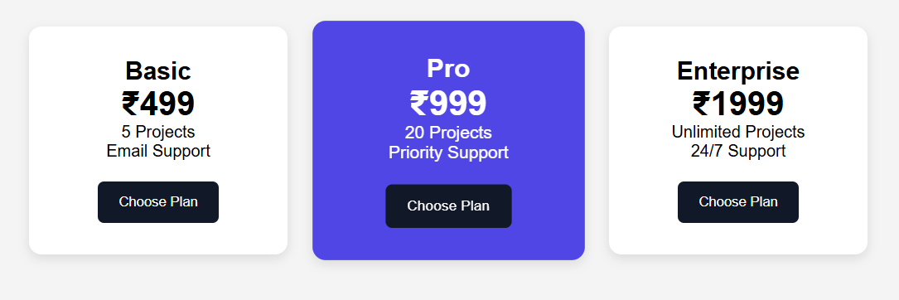
Problem Statements
Create a modern pricing section with 3 cards using only Flexbox.
Requirements:
Cards should appear in one row on desktop.
Equal spacing between cards.
Highlight the middle card.
Button at bottom of each card.
Use Flexbox for layout.
Expected Design

Slide 27
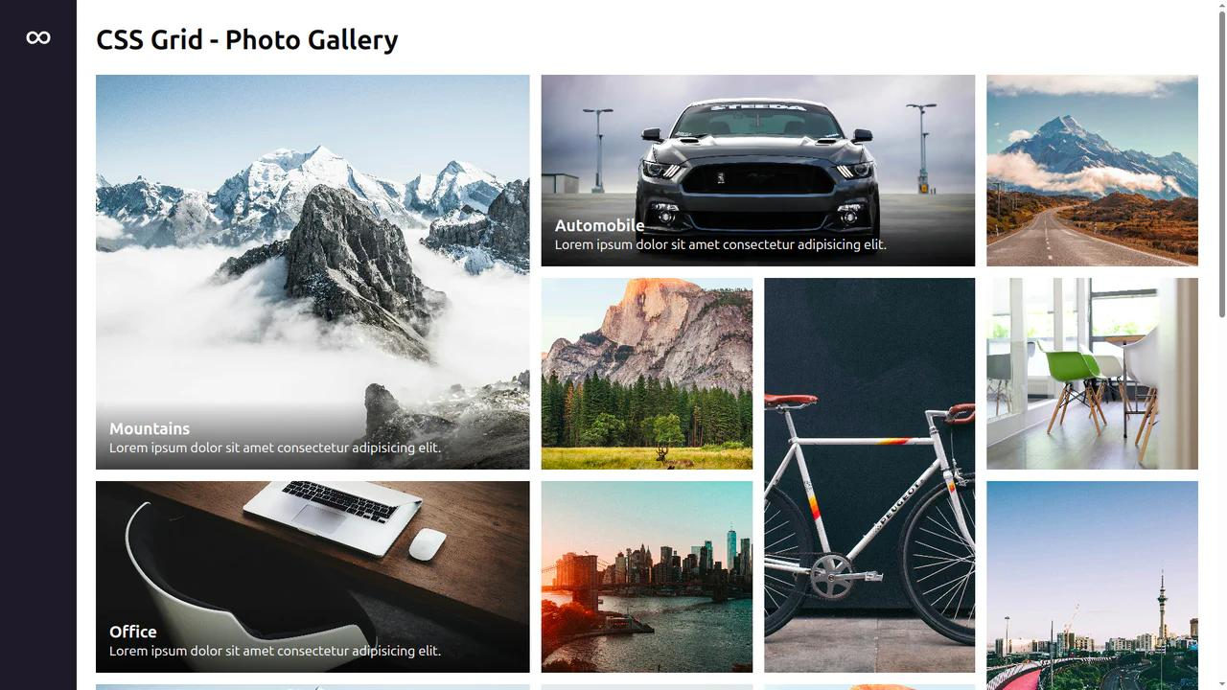
Problem Statements
Create a modern magazine/blog layout using CSS Grid.
Requirements:
One large featured article.
Four smaller cards.
Gap between all cards.
Rounded corners.
Hover effect.
Container width should be limited (not full screen).
Use grid-column and grid-row.
Expected Design

Slide 28
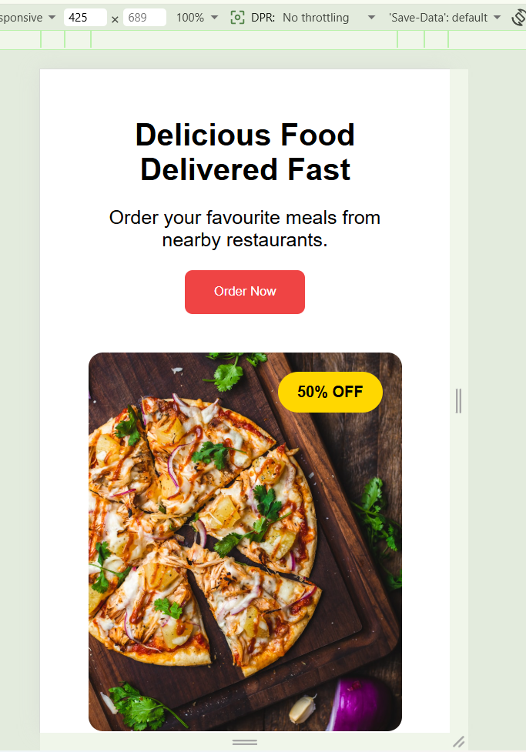
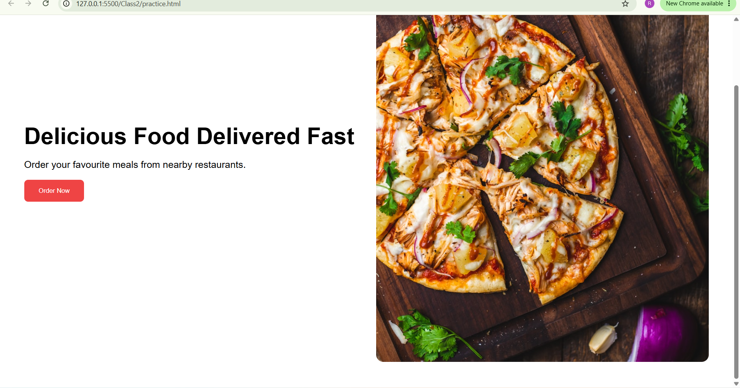
Problem Statements
Create a responsive food delivery landing page.
Requirements:
Navbar.
Hero Section.
Hero Image.
Floating discount badge using .
Position:absolute
Desktop → image and text side by side.
Mobile → image below text.
Expected Design

Slide 29
CSS Specificity & Cascade
Which CSS rule wins when there are conflicts?
Specificity Hierarchy (Higher = Wins)
!important
Overrides everything (avoid using)
Inline Styles
style='...' on the element
ID Selector #id
Most specific selector
Class .class / :pseudo
Medium specificity
Element p, h1, div
Lowest specificity
p { color: blue; } /* specificity: 0,0,1 */
.text { color: red; } /* specificity: 0,1,0 — wins over element */
#main { color: green; } /* specificity: 1,0,0 — wins over class */
<p style="color: pink"> /* specificity: inline — wins over #id */

Slide 30
What We Covered Today
🎨
✍️
📦
CSS Basics
Typography & Backgrounds
Flexbox
Selectors, Properties, Box Model, Combinators
font-size, color, font-family, background-image
display:flex, justify-content, align-items, gap
🗂️
🔄
📱
CSS Grid
Transitions & Animations
Responsive Design
grid-template-columns, rows, gap, span
@keyframes, transition, transform
Media queries, mobile-first, breakpoints
Next Up: JavaScript! 🚀

